Slide 1



HOW TO REDUCE BIAS IN INTERFAITH CONVERSATIONS
Practical Peace Solutions Session
© 2026 Peace Through Action ® USA
Notes:
Welcome! Thank you for choosing to join this session on How to Reduce Bias in Interfaith Conversations.
I’m looking forward to learning how we can increase peace in our relationships and communities.
I’m [state your first name and last name.] [State any role you hold that explains why you are leading this session.]
I’m leading this session as a volunteer with Peace Through Action USA.
Next Slide

Slide 2

Our Mission
Peace Through Action® USA inspires and equips everyday people to increase safety, belonging, and peace in their relationships and communities by cultivating their compassion and increasing their constructive communication and conflict resolution skills.
Be Peace.
Choose Peace.
Create Peace.
© 2026 Peace Through Action ® USA
2
Notes:
Peace Through Action helps everyday people, like us gathered now, do something to increase peace in our relationships and communities.
Next Slide

Slide 3
What We Do
  Explore issues of civic and social concern by producing events and resources.
  Promote examples of inspiring community peacebuilders.
  Encourage spiritual self-care and anchoring.
  Teach practical peace skills.
  Support personal and small group action planning for peace.
  Bolster community peacebuilding efforts.
  Advocate for a socially just society.
© 2026 Peace Through Action ® USA
3
Notes:
They go about their mission work several ways, including by producing sessions like this and supporting volunteers like me to present them.
Next Slide

Slide 4
Session Outline
Part 1: Orientation
Part 2: Lesson
Part 3: Guided Practice
Part 4: Applied Practice
Part 5: Reflection
Part 6: Call to Action
© 2026 Peace Through Action ® USA
4
Notes:
Activity developer, write an alternative session outline on the slide and in these notes if the PS module has a different structure or part names than our standard training structure and part names Otherwise, remove this paragraph and keep the standard note below.
Let’s review the session agenda. First up is an orientation to the rules of the road. Then I will present a short lesson. After that we will do what’s called guided practice to get comfortable with the real-life situation we are considering. After that we will do an applied practice to uncover a practical solution. We will take a moment to reflect on what we learned. And close out with a call to action. We should wrap up in about 30 minutes.
Next Slide

Slide 5
Orientation
© 2026 Peace Through Action ® USA
Notes:
Go to Next Slide

Slide 6




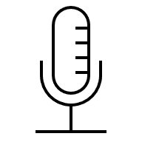







Start on Time | End on Time
Safety and Sociability
This session will begin and end on time..
Say Hi!
Introduce yourself in the chat.
Or Don’t Say Hi
Practice Mutual Respect
If you wish to stay anonymous, change your participant name, mute mic, keep video off.
Show kindness. Listen to each other.
We’re Recording
Share Personally
We are audio and video recording.
Use “I” statements when sharing.
Engage!
Include Everyone
Type questions and comments in chat. Or raise your hand to signal you want to share.
Take turns when sharing. Encourage, but don’t pressure, others to share.
Improve Your View
Assume Confidentiality
Use Speakers view or Gallery view.
What’s shared stays. What’s learned leaves.
© 2026 Peace Through Action ® USA
6
Notes:
Activity Leader: Show this slide and read the sentences below if you are making a virtual presentation. Otherwise, delete this slide and use the next slide instead.
I want to review the conditions we will have in place to ensure this session is safe and comfortable for all.
I hope we can connect with each other even in this virtual format. Please introduce yourself in the chat, sharing whatever information you want.
Unless you wish to stay anonymous. In that case, I recommend you change your participant name, mute your microphone, and keep your video off.
The session may be recorded.
Finally, we recommend you turn on Speakers view or Gallery view.
Let me propose a few ways we can make sure everyone feels safe, respected, and heard.
First, we will practice mutual respect. We will show kindness toward each other and listen to each other.
Second, we will use “I” statements and not speak for others.
Third, we will be mindful to not dominate the discussion. We will take turns when sharing. At the same time, we don’t want to pressure anyone to share.
Fourth, we will assume confidentiality. What is shared stays. What is learned leaves.
Next Slide

Slide 7




Start on Time | End on Time
Safety and Sociability
This session will begin and end on time.
Introduce Yourself
Provide whatever information about yourself you wish to share.
Or Maintain Your Privacy
Practice Mutual Respect
If you would rather not disclose your name or other information, that’s okay too.
Show kindness. Listen to each other.
We May Take Photos or Videos
Share Personally
If you don’t want to be included, let the person taking them know.
Use “I” statements when sharing.
It’s Okay to Move
Include Everyone
Sit, stand, and stretch as you wish.
Take turns when sharing. Encourage, but don’t pressure, others to share.
Step Away | Take Leave
Assume Confidentiality
Step away or leave as needed.
What’s shared stays. What’s learned leaves.
© 2026 Peace Through Action ® USA
7
Notes:
Activity Leader: Show this slide and read the sentences below if you are making an in-person presentation. Otherwise, delete this slide and use the prior slide instead.
I want to review the conditions we will have in place to ensure this session is safe and comfortable for all.
Be comfortable! Sit, stand, and stretch as you wish. Step away if you need.
Restrooms are located [provide direction]. A water fountain [or other water source] is located [provide direction]. If we would need to leave due to an emergency, the nearest exit is [provide direction.]
Let me propose a few ways we can make sure everyone feels safe, respected, and heard.
First, we will practice mutual respect. We will show kindness toward each other and listen to each other.
Second, we will use “I” statements and not speak for others.
Third, we will be mindful to not dominate the discussion. We will take turns when sharing. At the same time, we don’t want to pressure anyone to share.
Fourth, we will assume confidentiality. What is shared stays. What is learned leaves.
You may skip participant introductions if all participants know each other.
Let’s go around the group and introduce ourselves by our names. If you would rather not disclose your name or other information, that’s okay too.
Next Slide

Slide 8
Session Purpose
The purpose of this session is to help participants recognize and reduce bias in interfaith conversations using practical dialogue skills that lower defensiveness, promote understanding, and prevent harm.
  After the session, participants will be able to:
  Identify strategies for interrupting bias in interfaith conversations.
  Apply these strategies in real-life dialogue settings.
  Respond constructively when biased or misinformed comments arise.
© 2026 Peace Through Action ® USA
8
Notes:
Session Purpose
State the purpose of the session.
In this session, we are going to practice how to interrupt bias in interfaith conversations without escalating the conversation into tension or conflict.
These situations often happen quickly, casually, and under time pressure. Someone makes a comment, a joke, or a dismissal, and we’re left deciding whether to let it slide or risk making things awkward.
We will focus on a short, practical sequence you can use in those moments to slow the interaction, examine assumptions, and reduce harm even if the conversation doesn’t fully resolve.
By the end of this session, you will be able to:
Recognize when bias or assumptions are showing up through assumptions or generalizations.
Use a simple three-step strategy sequence to interrupt bias in real time.
Respond constructively even when the situation is imperfect or uncomfortable.
Next Slide

Slide 9
Lesson
© 2026 Peace Through Action ® USA
Notes:
Go to Next Slide

Slide 10
Three Practical Tools for Interrupting Bias
  Slow the claim
  Make the assumption explicit
  Offer a repair path
© 2026 Peace Through Action ® USA
10
Notes:
Lesson (5 Minutes)
Purpose (1 Minute)
Lesson
The Three-Step Bias Interruption Sequence (4 Minutes)
Three Practical Tools for Interrupting Bias in Interfaith Conversations
While bias can sometimes appear directly or blatantly hostile, it can often sound more casual, practical, or subtle. These are tools designed to interrupt that moment just enough to slow it down and reduce harm.
Step 1: Slow the Claim
What this means:
Pause the conversation by asking the speaker to be more specific about what they just said.
Why this works:
Broad or loaded statements lose momentum when specificity is required. Slowing the language slows the reaction.
You might say:
When you say that, who or what are you referring to specifically?
Is that something you’ve experienced directly, or something you’ve heard?
Can you say a bit more about what you mean by that?
Step 2: Make the Assumption Explicit
What this means:
Name the assumption you’re hearing and invite clarification or correction.
Why this works:
Bias often hides between what was said and what was unsaid. Identifying the assumption allows the speaker to adjust without feeling accused.
You might say:
It sounds like the assumption is that this practice is optional for everyone. Is that what you mean?
Just to check my understanding, are you saying that applies to all people in that faith?
Am I hearing that correctly or am I misunderstanding?
Step 3: Offer a Repair Path
What this means:
Invite the speaker to restate their point in a clearer or more specific way.
Why this works:
This gives the speaker a way to reset without losing face or doubling down.
You might say:
Would you be willing to say that again in a more specific way?
I think I get what you’re aiming at, can you rephrase it?
Let’s reset that. What specific concern are you trying to raise
You may not use all three steps every time. That still counts.
Success here means interrupting bias just enough to keep the conversation from sliding further and causing more harm.

Slide 11
Guided Practice
© 2026 Peace Through Action ® USA
Notes:
Go to Next Slide

Slide 12
Pairs Role-Play
  One speaker, one responder
  Practice interrupting bias in real time
  Focus on language and assumptions
  Goal is interruption, not persuasion
© 2026 Peace Through Action ® USA
12
Notes:
Guided Practice (4 Minutes)
Activity: Pairs Role-Play (4 minutes)
Guided Practice
Instructions:
Divide participants into pairs.
Direct participants to enact the role play using the scenario.
After participants have completed the role play, debrief as a whole group.
Please turn to a partner. We are going to act out a role-play now. One of you will play the “Speaker” and the other will play the “Responder.”
Scenario Options (choose one):
“I don’t really get why they need special accommodations. Religion should be a private thing.”
“That’s just how that religion is. They’re usually pretty strict about stuff like that.”
“Do we really need to change the plan for one person’s beliefs?”
“I’m not trying to be offensive, but that faith feels kind of outdated.”
“Everyone compromises sometimes. Why should this be any different?”
Constraints for the Responder:
You have about 90 seconds to respond.
Your goal is to interrupt bias, not persuade or debate.
You are not required to resolve the issue for reach an agreement.
Focus on language and assumptions, not intent or character.
Allow time for the role play for about two minutes total
Debrief:
Ask the responders first:
Which step of the sequence did you reach?”
“Where did the conversation naturally slow down or shift?”
Then ask the group:
“What felt most natural to say?”
What felt awkward or unfamiliar?”

Slide 13
Applied Practice
© 2026 Peace Through Action ® USA
Notes:
Go to Next Slide

Slide 14
Small Group Scenario Practice
  Groups of 4-5
  One speaker, one responder, observers
  Use the three-step sequence
  Notice where the interaction slows or shifts
© 2026 Peace Through Action ® USA
14
Notes:
Activity: Small Groups of 4-5 (5 Minutes)
Applied Practice
Instructions:
Divide participants into small groups of 4-5.
Direct participants to enact the role play using the scenario.
After participants have completed the role play, debrief as a whole group.
Now we are going to practice the same three-step sequence in a more realistic setting. Please form small groups of 4-5. Choose roles within your group:
One person will play the speaker.
One person will play the responder.
Everyone else will be the observers.
The scenario is: Your group is planning an event or meeting. One person raises a faith-based request, such as a dietary need or scheduling concern. Another person responds dismissively by saying:
“Do we really need to change the whole plan for that?”
This is happening in a setting where no one expects a long discussion about faith and there is a mild time pressure to move forward.
Each group will have three minutes total to run through the scenario.
Constraints for the Responder:
You are not the facilitator or meeting leader.
You do not have authority to set rules or procedures.
You want to keep this meeting moving, not derail it.
Given the context:
You have about 90 seconds total.
Your goal is to interrupt bias just enough to slow the moment.
You are not trying to persuade, debate, or reach an agreement.
Constraints for the Speaker
Deliver dismissive comment once.
Assume you are trying to be practical, not offensive.
Respond naturally if asked to clarify or rephrase.
Constraints for the Observers:
Observe silently.
Do not coach, correct, or intervene.
Listen for specific phrases.
Note at what moments the responders decide to shift from each step.
Debrief:
Start with Observers:
What is one phrase you heard that felt realistic and useful in a setting like this?
Where did the interaction slow down or shift?
Then invite responders:
Which step of the sequence felt easiest to use here?
Which step felt hardest under time or social pressure?

Slide 15
Reflection
© 2026 Peace Through Action ® USA
Notes:
Go to Next Slide

Slide 16
Integrating Strategies
  Which step felt most natural to use?
  Which step felt hardest in the moment?
  Where might this be useful in your life?
© 2026 Peace Through Action ® USA
16
Notes:
Integrating Strategies (3 Minutes)
Reflection
As a whole group, invite participants to reflect on what they learned.
Before we wrap up, let’s take a moment to reflect on what we just practiced.
Ask 2-3 of the following questions, depending on time:
Which step of the sequence felt most natural for you to use?
Which step felt the hardest to reach in the moment?
Was there a phrase you heard today that you could imagine using outside this room?
Where do you think this kind of interruption would be most useful in your own life?
Allow 2-4 brief responses.

Slide 17
Call to Action
© 2026 Peace Through Action ® USA
Notes:
Go to Next Slide

Slide 18
Key Takeaways
  Bias often shows up casually and under time pressure
  Interrupting bias does not require debate or resolution
  One well-placed sentence can reduce harm
  Slow the claim → Make the assumption explicit → Offer a repair path
© 2026 Peace Through Action ® USA
18
Notes:
Call to Action (8 Minutes)
Key Takeaways (1 Minute)
Call to Action
Key Takeaways
As we close, I want to reinforce that moments of bias or dismissal in interfaith conversations frequently arise without warning. They happen quickly, casually, and often when people are trying to move on.
What we practiced today is a way to interrupt those moments without escalating them. You now have a simple sequence that you can use when bias shows up: Slow the claim → Make the assumption explicit → Offer a repair path.
You don’t need to use every step every time. Even one well-places sentence can make a difference.

Slide 19
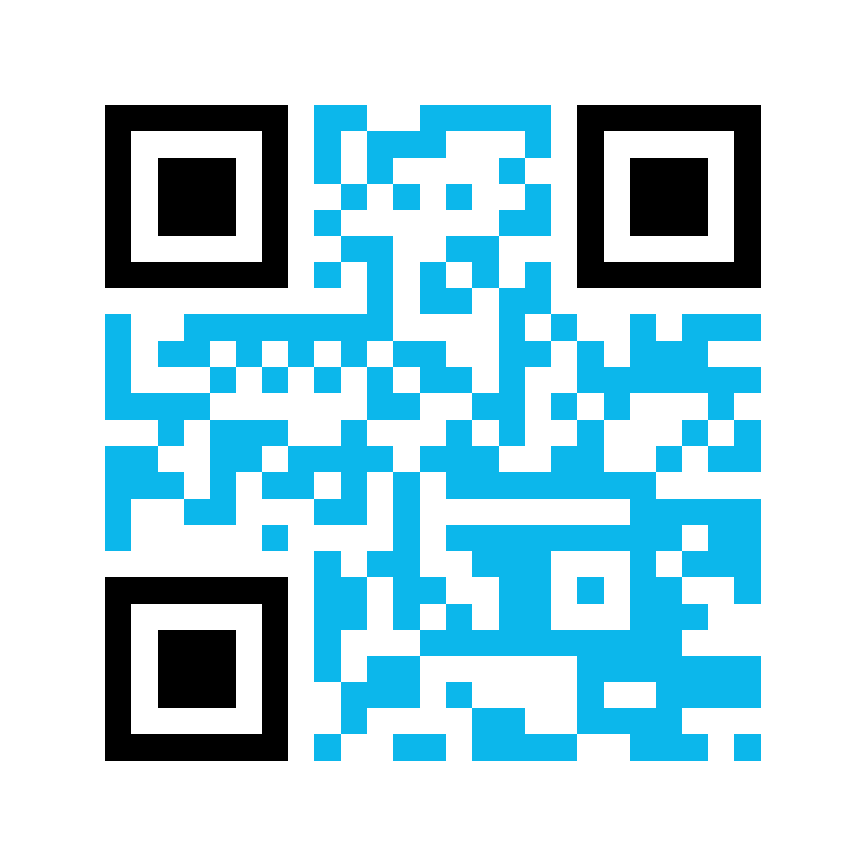
Complete
Tell us what you learned from this session. Please complete this short survey.
bit.ly/PeaceActPostSurvey
© 2026 Peace Through Action ® USA
19
Notes:
Distribute session summary sheets to participants.
Peace Through Action has prepared information for you to take with you. It has QR codes and weblinks to actions to continue what we started today.
Peace Through Action asks you to complete a brief survey about what you learned from this session. It helps them figure out if this session is doing what it’s supposed to. It also helps them report to donors and supporters.
If you are passing out print post session surveys…
I’m passing around the survey now.
If you are also directing/only directing participants to an online post-session survey…
You can complete the survey online (if using the PowerPoint presentation) or scan the QR code on this slide and complete the survey online.
I’m going to give us time to complete the survey before we go.
Pause 3 minutes while participants complete post-session survey.
Next Slide

Slide 20
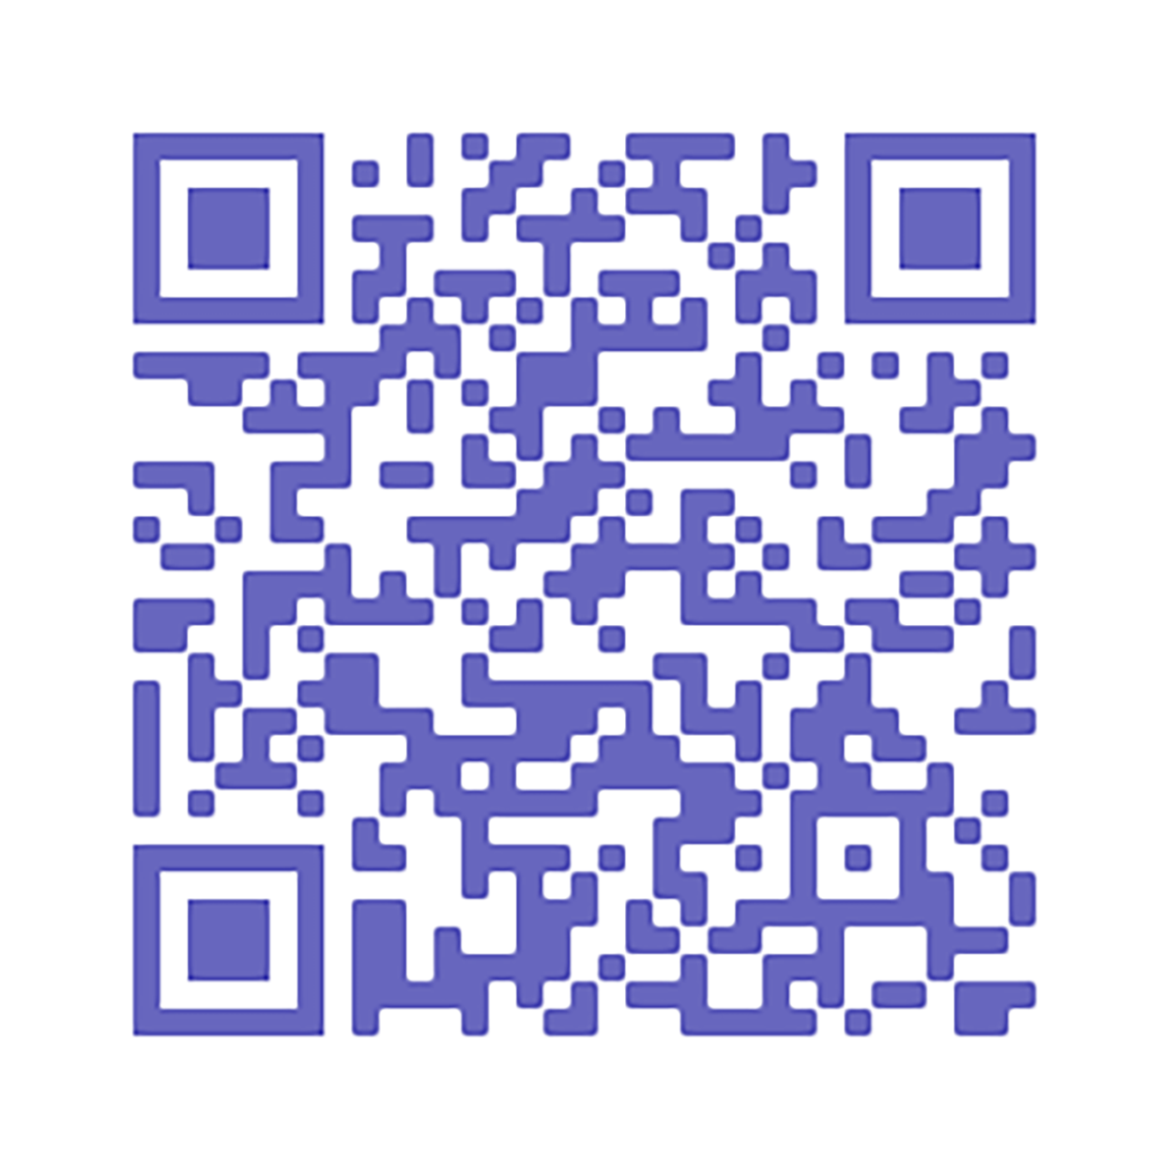
Sign Up
Keep up with us by email.
peacethroughaction.org/email
© 2026 Peace Through Action ® USA
20
Notes:
Also, Peace Through Action requests your email addresses so that they can follow up with you after this session and explore how they can help you continue your interest. Providing contact information is voluntary, of course, but I hope you will consider it. You can unsubscribe from their email any time.
If you are passing out a print sign-up sheet…
I’m passing around a sign-up sheet.
Pass around the sign-up sheet.
If you are also directing/only directing participants to an online sign-up sheet…
You can scan the QR code on the session summary or slide and sign up online.
Next Slide

Slide 21
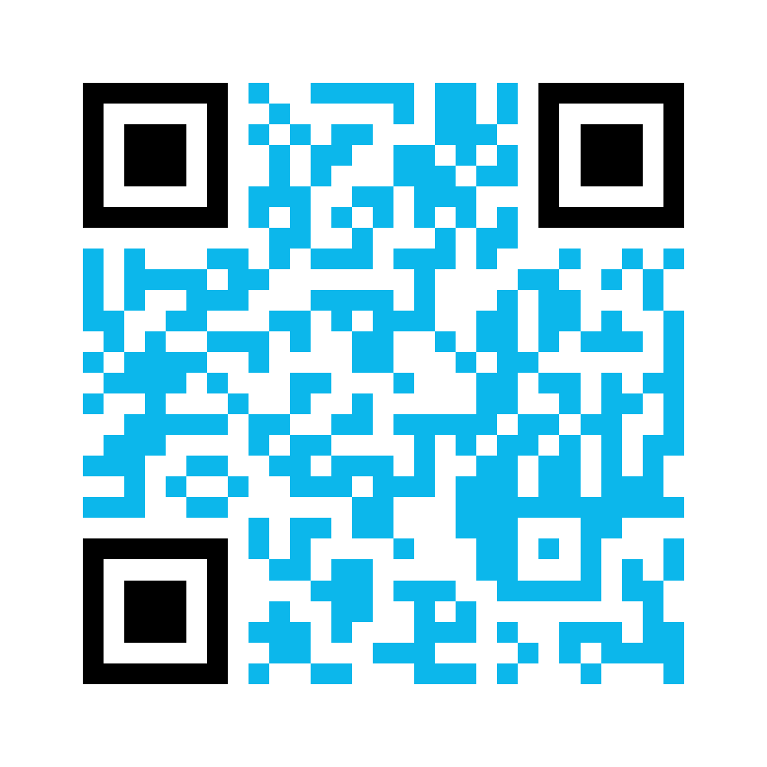
Consent
Complete our media release to give us permission to use your name, voice, and/or image.
bit.ly/PeaceActMediaRelease
© 2026 Peace Through Action ® USA
21
Notes:
If a group or individual picture will be taken at the conclusion of the session…
Before we go, I’d like to take a picture of our group. The picture will be a resource for Peace Through Action to show off our action and for us to share out with our friends and colleagues. Would that be okay?
If all or most participants consent…
Peace Through Action does request each of us to complete a media release so that they know your intentions with any pictures or videos taken today.
If you are passing out print media release forms…
Take a moment now to read and complete the media release form.
If you are also directing/only directing participants to an online media releasee form.
You can scan the QR code on the session summary or the slide and complete the media release form online.
Pause while participants complete media release forms.

Slide 22








Connect
@peaceactusa
linkedin.com/company/peace-through-action-usa
@peacethroughaction.org
© 2026 Peace Through Action ® USA
22
Notes:
Some other things you can do with Peace Through Action, all of which are covered in the session summary, include connecting with them on social media…
Next Slide

Slide 23
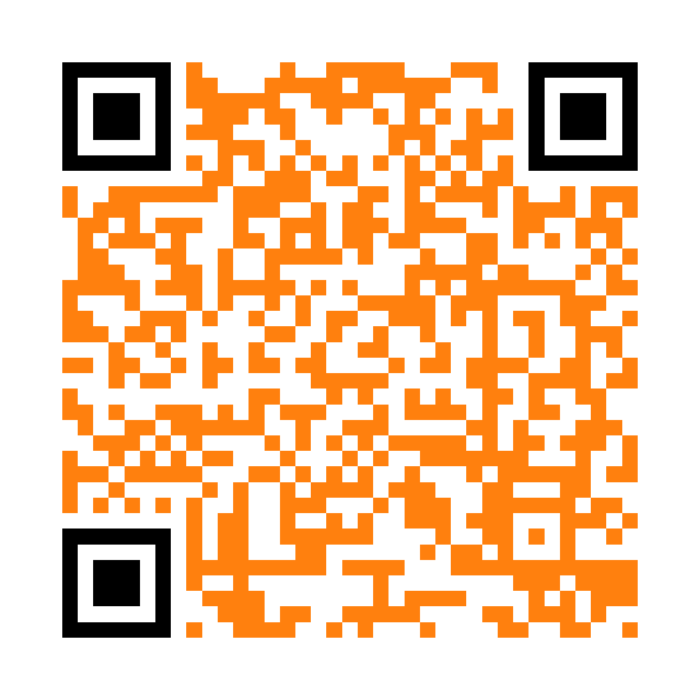
Volunteer
  Boost our social posts.
  Teach a peace skill.
  Host an action meet-up.
  Write issue briefs.
  Join our board of directors.
  Propose your own activity!
peacethroughaction.org/volunteer
© 2026 Peace Through Action ® USA
23
Notes:
…volunteering as an activity leader like I’m doing today…
Next Slide

Slide 24
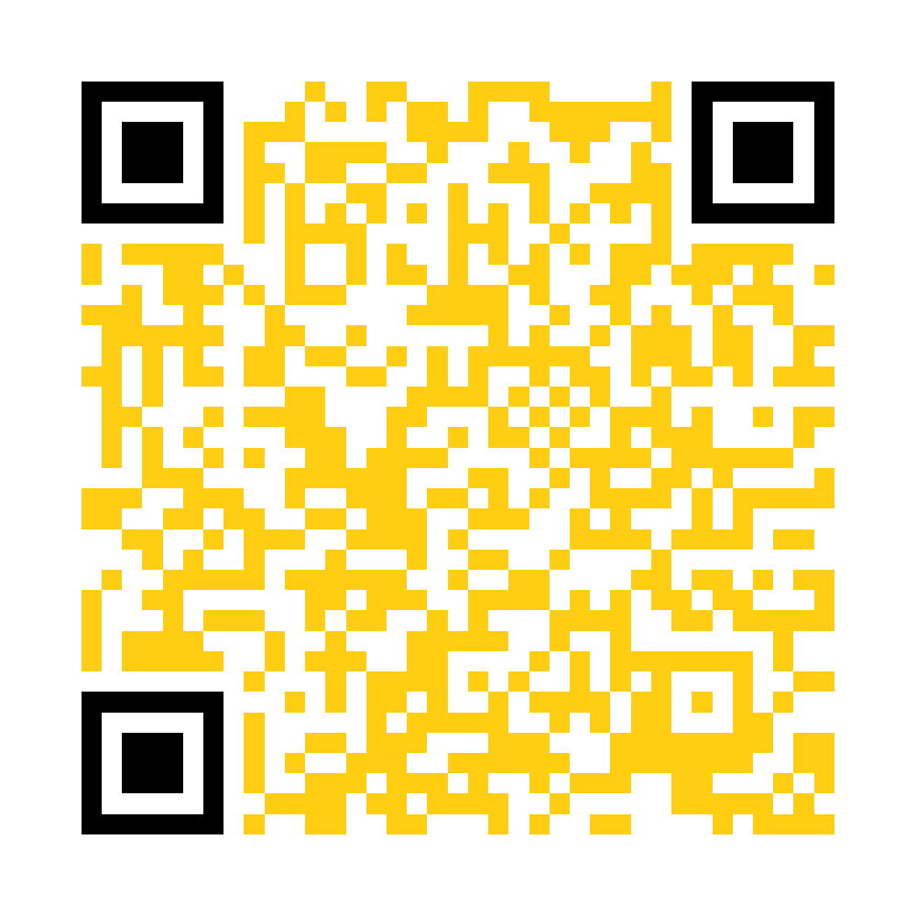
Give
Support our mission activities with a gift of money for peace.
peacethroughaction.org/give
© 2026 Peace Through Action ® USA
24
Notes:
… or giving a gift of money to support their mission work.
Next Slide

Slide 25
Peace Through Action USA
P.O. Box 73466
Washington DC 20056-3466
202-827-5967
peacethroughaction.org
inbox@peacethroughaction.org
Contact
© 2026 Peace Through Action ® USA
25
Notes:
I hope you have found this time together pleasant, useful, and meaningful. I can’t thank you enough for making time to learn about what you can do, and that we can do together, to increase peace in our relationships and communities. Thank you!

