Slide 1



How to Respond to Unfair or Harmful Behavior at Work
Practical Peace Solutions Session
© 2025 Peace Through Action ® USA
Notes:
Welcome! Thank you for choosing to join this session on [module title].
I’m looking forward to learning how we can increase peace in our relationships and communities.
I’m [state your first name and last name.] [State any role you hold that explains why you are leading this session.]
I’m leading this session as a volunteer with Peace Through Action USA.
Next Slide

Slide 2

Our Mission
Peace Through Action® USA inspires and equips everyday people to increase safety, belonging, and peace in their relationships and communities by cultivating their compassion and increasing their constructive communication and conflict resolution skills.
Be Peace.
Choose Peace.
Create Peace.
© 2025 Peace Through Action ® USA
2
Notes:
Peace Through Action helps everyday people, like us gathered now, do something to increase peace in our relationships and communities.
Next Slide

Slide 3
What We Do
  Explore issues of civic and social concern by producing events and resources.
  Promote examples of inspiring community peacebuilders.
  Encourage spiritual self-care and anchoring.
  Teach practical peace skills.
  Support personal and small group action planning for peace.
  Bolster community peacebuilding efforts.
  Advocate for a socially just society.
© 2025 Peace Through Action ® USA
3
Notes:
They go about their mission work several ways, including by producing sessions like this and supporting volunteers like me to present them.
Next Slide

Slide 4
Session Outline
Part 1: Orientation
Part 2: Lesson
Part 3: Guided Practice
Part 4: Applied Practice
Part 5: Reflection
Part 6: Call to Action
© 2025 Peace Through Action ® USA
4
Notes:
Let’s review the session agenda. First up is an orientation to the rules of the road. Then I will present a short lesson. After that we will do what’s called guided practice to get comfortable with the real-life situation we are considering. After that we will do an applied practice to uncover a practical solution. We will take a moment to reflect on what we learned. And close out with a call to action. We should wrap up in about 30 minutes.
Next Slide

Slide 5
Orientation
© 2025 Peace Through Action ® USA
Notes:
Go to Next Slide

Slide 6












Start on Time | End on Time
Safety and Sociability
This session will begin and end on time..
Say Hi!
Introduce yourself in the chat.
Or Don’t Say Hi
Practice Mutual Respect
If you wish to stay anonymous, change your participant name, mute mic, keep video off.
Show kindness. Listen to each other.
We’re Recording
Share Personally
We are audio and video recording.
Use “I” statements when sharing.
Engage!
Include Everyone
Type questions and comments in chat. Or raise your hand to signal you want to share.
Take turns when sharing. Encourage, but don’t pressure, others to share.
Improve Your View
Assume Confidentiality
Use Speakers view or Gallery view.
What’s shared stays. What’s learned leaves.
© 2025 Peace Through Action ® USA
6
Notes:
Activity Leader: Show this slide and read the sentences below if you are making a virtual presentation. Otherwise, delete this slide and use the next slide instead.
I want to review the conditions we will have in place to ensure this session is safe and comfortable for all.
I hope we can connect with each other even in this virtual format. Please introduce yourself in the chat, sharing whatever information you want.
Unless you wish to stay anonymous. In that case, I recommend you change your participant name, mute your microphone, and keep your video off.
The session may be recorded.
Finally, we recommend you turn on Speakers view or Gallery view.
Let me propose a few ways we can make sure everyone feels safe, respected, and heard.
First, we will practice mutual respect. We will show kindness toward each other and listen to each other.
Second, we will use “I” statements and not speak for others.
Third, we will be mindful to not dominate the discussion. We will take turns when sharing. At the same time, we don’t want to pressure anyone to share.
Fourth, we will assume confidentiality. What is shared stays. What is learned leaves.
Next Slide

Slide 7




Start on Time | End on Time
Safety and Sociability
This session will begin and end on time.
Introduce Yourself
Provide whatever information about yourself you wish to share.
Or Maintain Your Privacy
Practice Mutual Respect
If you would rather not disclose your name or other information, that’s okay too.
Show kindness. Listen to each other.
We May Take Photos or Videos
Share Personally
If you don’t want to be included, let the person taking them know.
Use “I” statements when sharing.
It’s Okay to Move
Include Everyone
Sit, stand, and stretch as you wish.
Take turns when sharing. Encourage, but don’t pressure, others to share.
Step Away | Take Leave
Assume Confidentiality
Step away or leave as needed.
What’s shared stays. What’s learned leaves.
© 2025 Peace Through Action ® USA
7
Notes:
Activity Leader: Show this slide and read the sentences below if you are making an in-person presentation. Otherwise, delete this slide and use the prior slide instead.
I want to review the conditions we will have in place to ensure this session is safe and comfortable for all.
Be comfortable! Sit, stand, and stretch as you wish. Step away if you need.
Restrooms are located [provide direction]. A water fountain [or other water source] is located [provide direction]. If we would need to leave due to an emergency, the nearest exit is [provide direction.]
Let me propose a few ways we can make sure everyone feels safe, respected, and heard.
First, we will practice mutual respect. We will show kindness toward each other and listen to each other.
Second, we will use “I” statements and not speak for others.
Third, we will be mindful to not dominate the discussion. We will take turns when sharing. At the same time, we don’t want to pressure anyone to share.
Fourth, we will assume confidentiality. What is shared stays. What is learned leaves.
You may skip participant introductions if all participants know each other.
Let’s go around the group and introduce ourselves by our names. If you would rather not disclose your name or other information, that’s okay too.
Next Slide

Slide 8
Session Purpose
The purpose of this session is to help participants respond firmly and calmly to unfair or harmful behavior, reducing tension, protecting dignity, and inviting accountability and repair.
  After the session, participants will be able to:
  Use practical strategies to interrupt harmful behavior without escalating conflict.
  Practice responding in realistic workplace scenarios.
  Increase confidence acting as a responder or bystander.
© 2025 Peace Through Action ® USA
8
Notes:
We are going to learn how to respond to unfair or harmful behavior at work in ways that reduce harm, protect dignity, and invite accountability and repair.
By the end of this session you will be able to pause, name shared standards, and invite repair when harmful behavior occurs at work.
Next Slide

Slide 9
Lesson
© 2025 Peace Through Action ® USA
Notes:
Go to Next Slide

Slide 10
Three Key Strategies for Responding to Harm at Work
  Buy Time
  Name the Standard
  Call-In for Repair
© 2025 Peace Through Action ® USA
10
Notes:
Three Key Strategies for Responding to Harm at Work (3 Minutes)
Three Key Strategies for Reducing Harm at Work
1.) Buy Time
Create a pause so you can respond instead of react.
Examples:
“Let’s pause for a moment.”
“I need a second to think about that.”
2.) Name the Standard
Anchor the response in a shared workplace value or norm.
Examples:
“Let’s keep this respectful – everyone’s input matters here.”
“On our team, we don’t make comments about someone’s identity.”
3.) Call-In for Repair
Invite a do-over with dignity, rather than shaming.
Examples:
“Would you like to rephrase that?”
“Can we try that again in a more constructive way?”
You can use one, two, or all three. The goal is to reduce harm and invite better behavior, not win an argument.

Slide 11
Guided Practice
© 2025 Peace Through Action ® USA
Notes:
Go to Next Slide

Slide 12
Workplace Pairs Practice
  Scenario:
  In a meeting, someone says:
  “We don’t need more input from you on this.”
© 2025 Peace Through Action ® USA
12
Notes:
Guided Practice (4 Minutes)
Workplace Pairs Practice (4 Minutes)
Guided Practice
Instructions:
Divide participants into pairs.
One person plays the Speaker, the other the Responder.
Scenario:
In a meeting, someone says:
“We don’t need more input from you on this.”
Constraints for the Responder:
You have about 2 minutes.
You want to reduce harm without escalating.
You may use one or more of the three strategies.
Responder: Use Buy Time, Name the Standard, or the Call-In strategies, as appropriate.
Switch roles halfway through.
Debrief:
What made the response feel firm but not aggressive? What language helped lower tension?

Slide 13
Applied Practice
© 2025 Peace Through Action ® USA
Notes:
Go to Next Slide

Slide 14
High-Stakes Workplace Scenario (Groups of 4-5)
  Scenario:
  A senior peer says to a teammate in front of others:
  “You’re always slowing us down.”
© 2025 Peace Through Action ® USA
14
Notes:
Applied Practice (6 Minutes)
High-Stakes Workplace Scenario (Groups of 4-5) (6 Minutes)
Applied Practice
Instructions:
Form groups of 4-5. Assign the following roles:
Target
Responder
Bystander or Manager
Observers
Scenario:
A senior peer says to a teammate in front of others:
“You’re always slowing us down.”
Constraints for the Responder:
The comment happened publicly.
Power dynamics are present.
You must keep the response under 3 minutes.
The goal is de-escalation and repair.
Responder: Use the Buy Time, Name the Standard, and Call-In strategies, as appropriate.
Observers: Capture exact phrases that reduced harm or invited repair.
Debrief:
Observers share one phrase that worked well and why.

Slide 15
Reflection
© 2025 Peace Through Action ® USA
Notes:
Go to Next Slide

Slide 16
Reflection
  One-Word Takeaways
© 2025 Peace Through Action ® USA
16
Notes:
Reflection (3 Minutes)
One-Word Takeaway (3 Minutes)
Reflection
Think of one word that captures what you’re taking away from this workplace-focused session – perhaps one of the strategies, a feeling, or a commitment.
We’ll go around quickly and share. I’ll start: “steadiness.”
After the group has completed sharing, invite the participants to ask any questions they may have to increase their understanding.

Slide 17
Call to Action
© 2025 Peace Through Action ® USA
Notes:
Go to Next Slide

Slide 18
Key Takeaways
© 2025 Peace Through Action ® USA
18
Notes:
Call to Action
Key Takeaways (1 Minute)
Call to Action
Key Takeaways
As we get close to completing this session, I want to reinforce that responding to harm requires small, steady actions. By taking intentional and often imperfect steps like pausing, naming standards, and inviting repair, we can reduce harm and increase a sense of belonging.

Slide 19
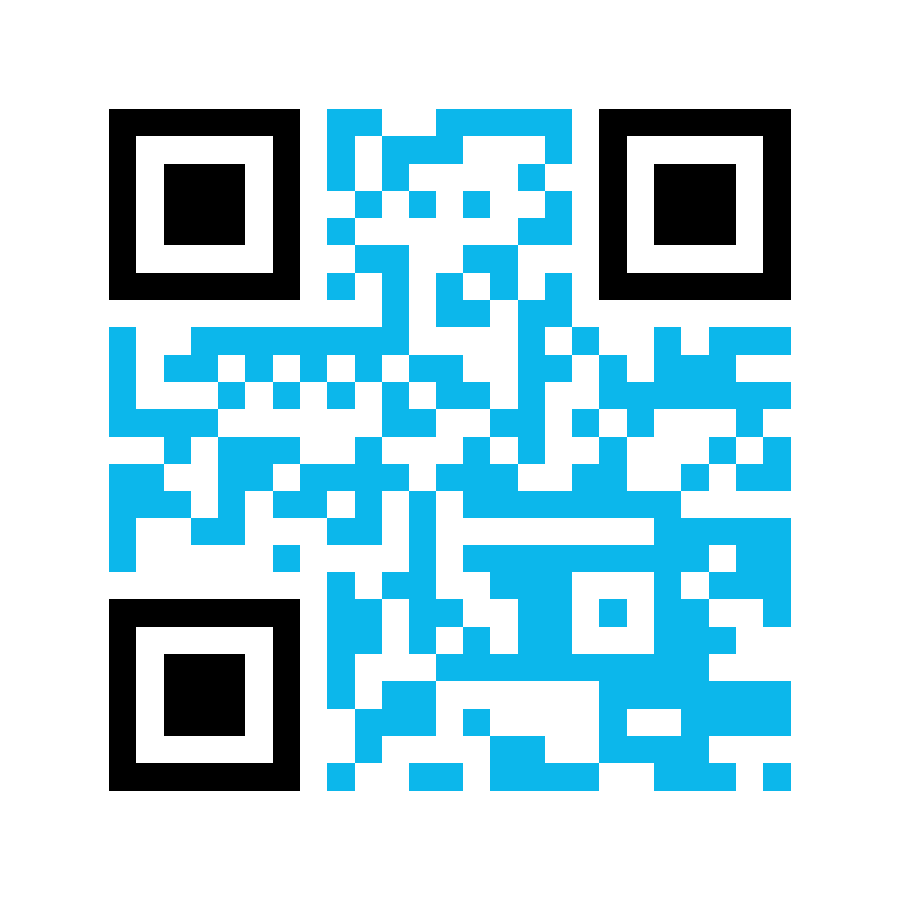
Complete
Tell us what you learned from this session. Please complete this short survey.
bit.ly/PeaceActPostSurvey
© 2025 Peace Through Action ® USA
19
Notes:
Distribute session summary sheets to participants.
Peace Through Action has prepared information for you to take with you. It has QR codes and weblinks to actions to continue what we started today.
Peace Through Action asks you to complete a brief survey about what you learned from this session. It helps them figure out if this session is doing what it’s supposed to. It also helps them report to donors and supporters.
If you are passing out print post session surveys…
I’m passing around the survey now.
If you are also directing/only directing participants to an online post-session survey…
You can complete the survey online (if using the PowerPoint presentation) or scan the QR code on this slide and complete the survey online.
I’m going to give us time to complete the survey before we go.
Pause 3 minutes while participants complete post-session survey.
Next Slide

Slide 20
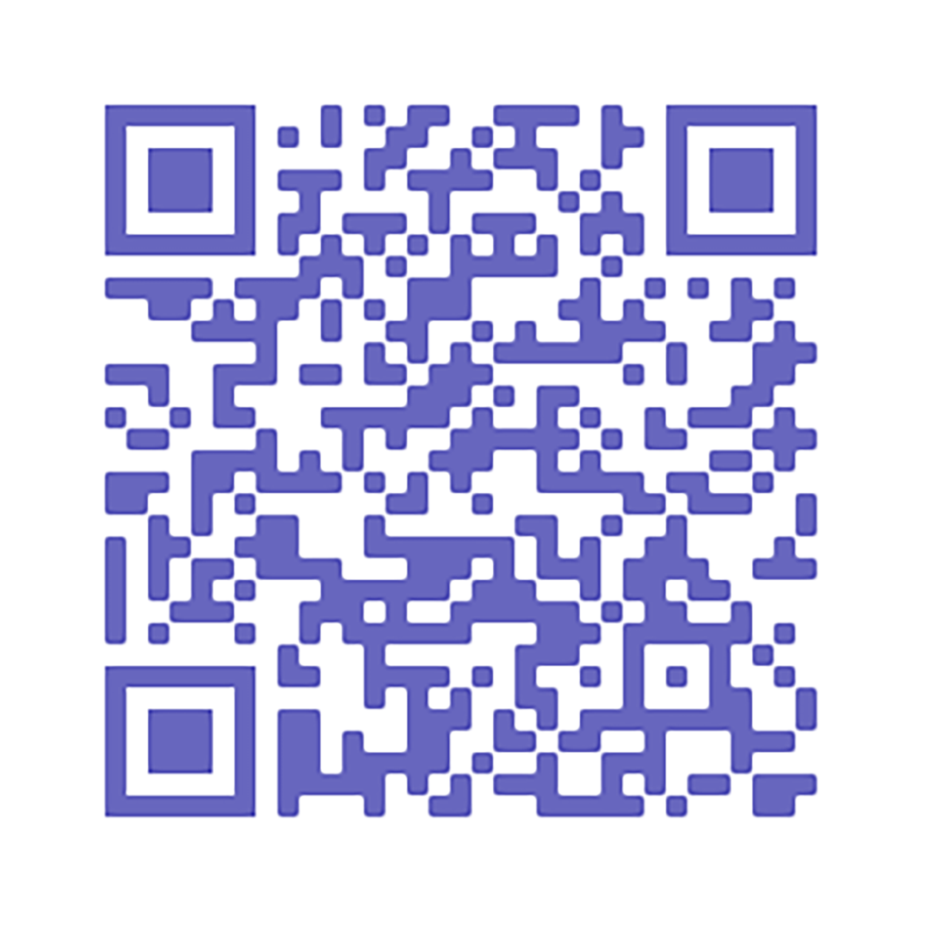
Sign Up
Keep up with us by email.
peacethroughaction.org/email
© 2025 Peace Through Action ® USA
20
Notes:
Also, Peace Through Action requests your email addresses so that they can follow up with you after this session and explore how they can help you continue your interest. Providing contact information is voluntary, of course, but I hope you will consider it. You can unsubscribe from their email any time.
If you are passing out a print sign-up sheet…
I’m passing around a sign-up sheet.
Pass around the sign-up sheet.
If you are also directing/only directing participants to an online sign-up sheet…
You can scan the QR code on the session summary or slide and sign up online.
Next Slide

Slide 21
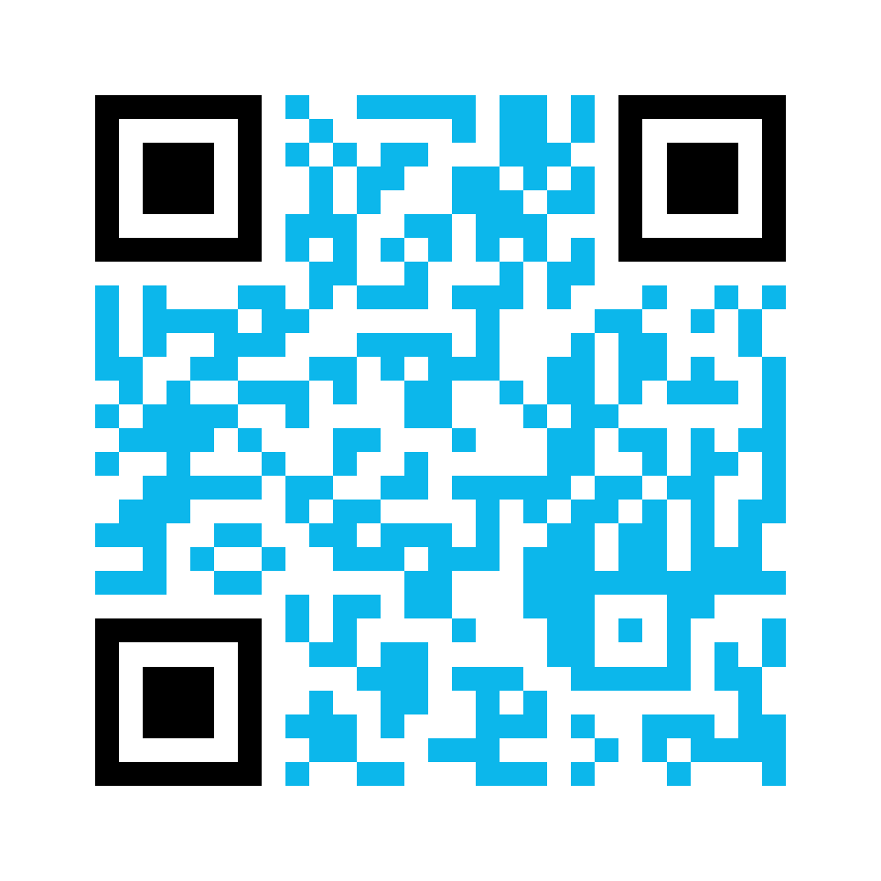
Consent
Complete our media release to give us permission to use your name, voice, and/or image.
bit.ly/PeaceActMediaRelease
© 2025 Peace Through Action ® USA
21
Notes:
If a group or individual picture will be taken at the conclusion of the session…
Before we go, I’d like to take a picture of our group. The picture will be a resource for Peace Through Action to show off our action and for us to share out with our friends and colleagues. Would that be okay?
If all or most participants consent…
Peace Through Action does request each of us to complete a media release so that they know your intentions with any pictures or videos taken today.
If you are passing out print media release forms…
Take a moment now to read and complete the media release form.
If you are also directing/only directing participants to an online media releasee form.
You can scan the QR code on the session summary or the slide and complete the media release form online.
Pause while participants complete media release forms.

Slide 22








Connect
@peaceactusa
linkedin.com/company/peace-through-action-usa
@peacethroughaction.org
© 2025 Peace Through Action ® USA
22
Notes:
Some other things you can do with Peace Through Action, all of which are covered in the session summary, include connecting with them on social media…
Next Slide

Slide 23
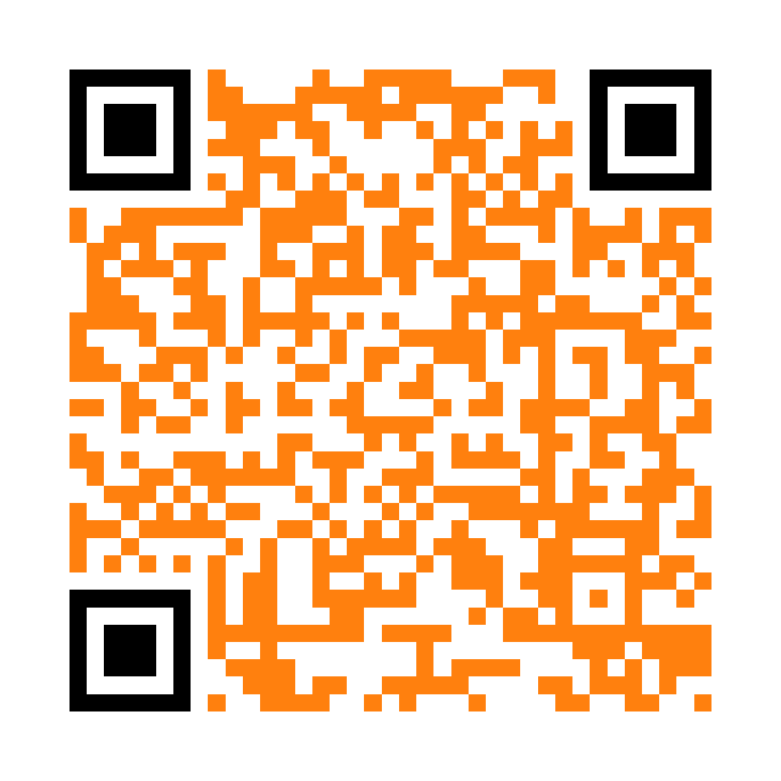
Volunteer
  Boost our social posts.
  Teach a peace skill.
  Host an action meet-up.
  Write issue briefs.
  Join our board of directors.
  Propose your own activity!
peacethroughaction.org/volunteer
© 2025 Peace Through Action ® USA
23
Notes:
…volunteering as an activity leader like I’m doing today…
Next Slide

Slide 24
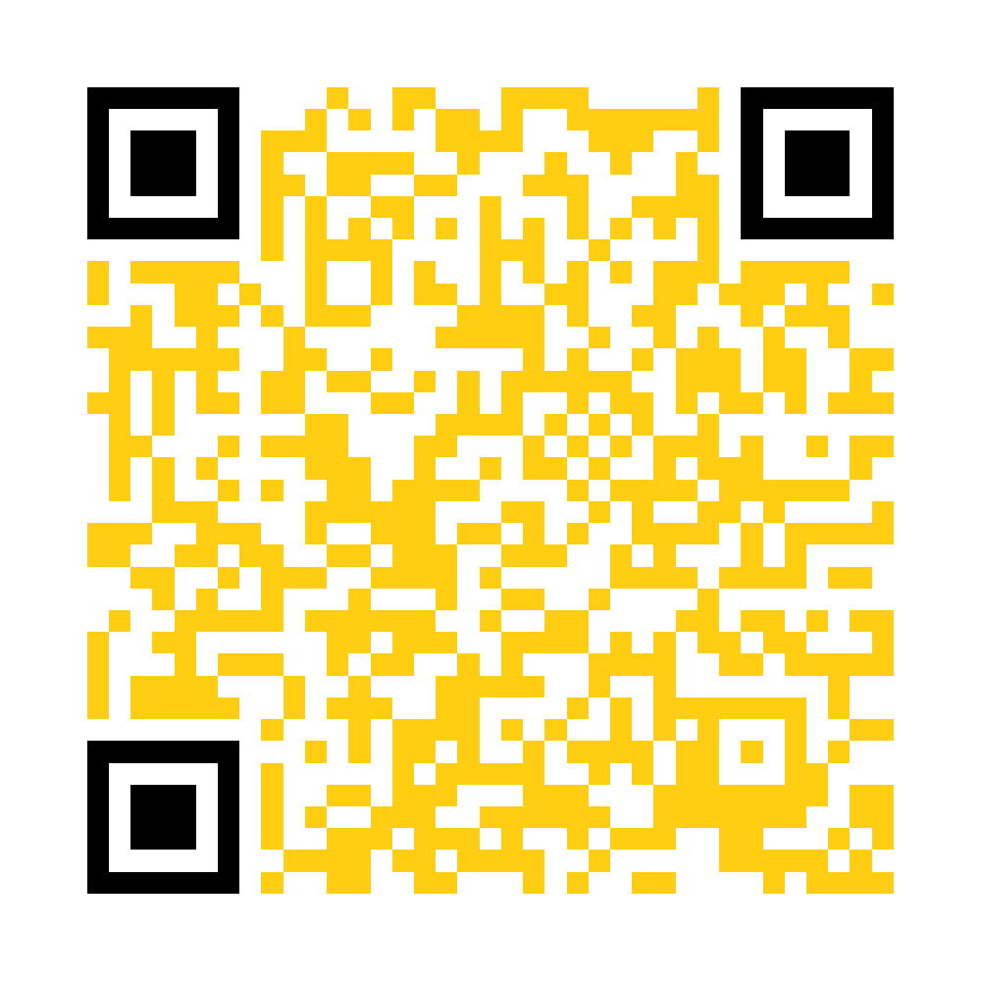
Give
Support our mission activities with a gift of money for peace.
peacethroughaction.org/give
© 2025 Peace Through Action ® USA
24
Notes:
… or giving a gift of money to support their mission work.
Next Slide

Slide 25
Peace Through Action USA
P.O. Box 73466
Washington DC 20056-3466
202-827-5967
peacethroughaction.org
inbox@peacethroughaction.org
Contact
© 2025 Peace Through Action ® USA
25
Notes:
I hope you have found this time together pleasant, useful, and meaningful. I can’t thank you enough for making time to learn about what you can do, and that we can do together, to increase peace in our relationships and communities. Thank you!

