Slide 1



HOW TO RESOLVE WORKPLACE CONFLICTS ACROSS POWER DIVIDES
Practical Peace Solutions Session
© YYYY Peace Through Action ® USA
Notes:
Welcome! Thank you for choosing to join this session on How to Resolve Workplace Conflicts Across Power Divides.
I’m looking forward to learning how we can increase peace in our relationships and communities.
I’m [state your first name and last name.] [State any role you hold that explains why you are leading this session.]
I’m leading this session as a volunteer with Peace Through Action USA.
Next Slide

Slide 2

Our Mission
Peace Through Action® USA inspires and equips everyday people to increase safety, belonging, and peace in their relationships and communities by cultivating their compassion and increasing their constructive communication and conflict resolution skills.
Be Peace.
Choose Peace.
Create Peace.
© YYYY Peace Through Action ® USA
2
Notes:
Peace Through Action helps everyday people, like us gathered now, do something to increase peace in our relationships and communities.
Next Slide

Slide 3
What We Do
  Explore issues of civic and social concern by producing events and resources.
  Promote examples of inspiring community peacebuilders.
  Encourage spiritual self-care and anchoring.
  Teach practical peace skills.
  Support personal and small group action planning for peace.
  Bolster community peacebuilding efforts.
  Advocate for a socially just society.
© YYYY Peace Through Action ® USA
3
Notes:
They go about their mission work several ways, including by producing sessions like this and supporting volunteers like me to present them.
Next Slide

Slide 4
Session Outline
Part 1: Orientation
Part 2: Lesson
Part 3: Guided Practice
Part 4: Applied Practice
Part 5: Reflection
Part 6: Call to Action
© YYYY Peace Through Action ® USA
4
Notes:
Let’s review the session agenda. First up is an orientation to the rules of the road. Then I will present a short lesson. After that we will do what’s called guided practice to get comfortable with the real-life situation we are considering. After that we will do an applied practice to uncover a practical solution. We will take a moment to reflect on what we learned. And close out with a call to action. We should wrap up in about 30 minutes.
Next Slide

Slide 5
Orientation
© YYYY Peace Through Action ® USA
Notes:
Go to Next Slide

Slide 6




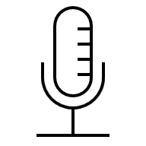







Start on Time | End on Time
Safety and Sociability
This session will begin and end on time..
Say Hi!
Introduce yourself in the chat.
Or Don’t Say Hi
Practice Mutual Respect
If you wish to stay anonymous, change your participant name, mute mic, keep video off.
Show kindness. Listen to each other.
We’re Recording
Share Personally
We are audio and video recording.
Use “I” statements when sharing.
Engage!
Include Everyone
Type questions and comments in chat. Or raise your hand to signal you want to share.
Take turns when sharing. Encourage, but don’t pressure, others to share.
Improve Your View
Assume Confidentiality
Use Speakers view or Gallery view.
What’s shared stays. What’s learned leaves.
© YYYY Peace Through Action ® USA
6
Notes:
Activity Leader: Show this slide and read the sentences below if you are making a virtual presentation. Otherwise, delete this slide and use the next slide instead.
I want to review the conditions we will have in place to ensure this session is safe and comfortable for all.
I hope we can connect with each other even in this virtual format. Please introduce yourself in the chat, sharing whatever information you want.
Unless you wish to stay anonymous. In that case, I recommend you change your participant name, mute your microphone, and keep your video off.
The session may be recorded.
Finally, we recommend you turn on Speakers view or Gallery view.
Let me propose a few ways we can make sure everyone feels safe, respected, and heard.
First, we will practice mutual respect. We will show kindness toward each other and listen to each other.
Second, we will use “I” statements and not speak for others.
Third, we will be mindful not to dominate the discussion. We will take turns when sharing. At the same time, we don’t want to pressure anyone to share.
Fourth, we will assume confidentiality. What is shared stays. What is learned leaves.
Next Slide

Slide 7



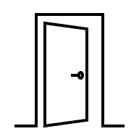
Start on Time | End on Time
Safety and Sociability
This session will begin and end on time.
Introduce Yourself
Provide whatever information about yourself you wish to share.
Or Maintain Your Privacy
Practice Mutual Respect
If you would rather not disclose your name or other information, that’s okay too.
Show kindness. Listen to each other.
We May Take Photos or Videos
Share Personally
If you don’t want to be included, let the person taking them know.
Use “I” statements when sharing.
It’s Okay to Move
Include Everyone
Sit, stand, and stretch as you wish.
Take turns when sharing. Encourage, but don’t pressure, others to share.
Step Away | Take Leave
Assume Confidentiality
Step away or leave as needed.
What’s shared stays. What’s learned leaves.
© YYYY Peace Through Action ® USA
7
Notes:
Activity Leader: Show this slide and read the sentences below if you are making an in-person presentation. Otherwise, delete this slide and use the prior slide instead.
I want to review the conditions we will have in place to ensure this session is safe and comfortable for all.
Be comfortable! Sit, stand, and stretch as you wish. Step away if you need.
Restrooms are located [provide direction]. A water fountain [or other water source] is located [provide direction]. If we need to leave due to an emergency, the nearest exit is [provide direction.]
Let me propose a few ways we can make sure everyone feels safe, respected, and heard.
First, we will practice mutual respect. We will show kindness toward each other and listen to each other.
Second, we will use “I” statements and not speak for others.
Third, we will be mindful not to dominate the discussion. We will take turns when sharing. At the same time, we don’t want to pressure anyone to share.
Fourth, we will assume confidentiality. What is shared stays. What is learned leaves.
You may skip participant introductions if all participants know each other.
Let’s go around the group and introduce ourselves by our names. If you would rather not disclose your name or other information, that’s okay too.
Next Slide

Slide 8
Session Purpose
The purpose of this module is to help participants navigate workplace conflicts across power divides by voicing truth with respect, protecting relationships, and improving work outcomes through naming what’s at stake and proposing a path forward.
  After the session, participants will be able to:
  Apply three strategies for speaking across power divides.
  Practice using these tools in role-plays and scenarios.
  Gain confidence addressing conflicts where hierarchy is at play.
© YYYY Peace Through Action ® USA
8
Notes:
We are going to learn to navigate workplace conflicts across power divides by voicing truth with respect, protecting relationships, and improving work outcomes through naming what’s at stake and proposing a path forward.
By the end of this session you will be able to:
Apply three strategies for speaking across power divides.
Practice using these tools in role-plays and scenarios.
Gain confidence addressing conflicts where hierarchy is at play.
Next Slide

Slide 9
Lesson
© YYYY Peace Through Action ® USA
Notes:
Go to Next Slide

Slide 10
Three Key Strategies Across Power Divides
  Lead with Curiosity
    Ask a genuine question to lower defensiveness.
    Example: “Can you help me understand which deliverable is top priority today?”
  Name the Stakes
    Connect your concern to shared outcomes.
    Example: “If we rush, we risk errors that could affect the client relationship.”
  Offer a Yes-And Solution
    Pair agreement with a workable path forward.
    Examples: “Yes, I can prioritize this – and I’ll need to move X to next week.
© YYYY Peace Through Action ® USA
10
Notes:
Now we’re going to walk through three tools you can use when you need to raise a concern with someone who has more authority, influence, or power than you. These moments can feel delicate, but these strategies help keep the conversation respectful and productive.
The first strategy is Lead with Curiosity.
This means opening the conversation with a genuine, non-loaded question. Curiosity lowers defensiveness because it shows the other person that you’re seeking clarity, not trying to challenge or undermine them.
For example, you might say: “Can you help me understand which deliverable is the top priority today?”
This does two things. It communicates openness, and it slows down the emotional temperature in the conversation.
The second strategy is Name the Stakes.
Here you frame your concern around shared outcomes—not your personal stress or frustration. This helps the other person see that you’re aligned and that your intention is to support the work, not complain.
For example: “If we rush this, we risk errors that could affect the client relationship.”
Naming the stakes grounds the conversation in what matters most for the team or organization.
The third strategy is Offer a Yes-And Solution.
This involves acknowledging the request or concern, then proposing a workable path forward. You’re saying “yes” to the priority and clarifying what will need to shift to make it happen.
For example: “Yes, I can prioritize this—and I’ll need to move X to next week. Does that work?”
Used in sequence—Curiosity, Stakes, Yes-And—these tools turn a risky pushback into a collaborative problem-solving moment. They show respect, preserve the relationship, and improve the outcome.
Next slide

Slide 11
Guided Practice
© YYYY Peace Through Action ® USA
Notes:
Go to Next Slide

Slide 12
Guided Practice: Role-Play
  Scenario: Major deliverable assigned in 48 hours.
  Use: Curiosity → Stakes → Yes-And
© YYYY Peace Through Action ® USA
12
Notes:
Now we’re going to practice these strategies in pairs so you can try them out in a realistic situation.
Please turn to someone near you and pair up.
One person will play the Employee, and the other will play the Manager.
Here’s your scenario:
Your manager has just assigned a major deliverable that’s due in 48 hours, but your workload is already full. Your task, as the Employee, is to respond using the sequence we just learned: Lead with Curiosity, Name the Stakes, and Offer a Yes-And Solution.
You’ll have one minute and forty-five seconds for the first round.
Then switch roles so the other person can practice as well.
Go ahead and begin your first round now.
PAUSE and monitor the room.
OK, let’s switch roles so the other person can practice.
PAUSE again.
Great. Let’s come back together.
I’d like to hear from a few of you.
What phrases helped lower defensiveness?
What made your message sound more collaborative and less confrontational?
Allow participants to share for a moment.
Next slide.

Slide 13
Applied Practice
© YYYY Peace Through Action ® USA
Notes:
Go to Next Slide

Slide 14
Applied Practice
  Small Groups of 4 - 5 people
  Scenario: Concern was dismissed before as “complaining”
  Employee uses: Curiosity → Stakes → Yes-And
  Observers write down or note phrases that lowered defensiveness
© YYYY Peace Through Action ® USA
14
Notes:
Now we’re going to build on what you just practiced by working in slightly larger groups.
Please form groups of four to five people.
Choose one person to play the Employee, one to play the Manager, and the remaining people will be Observers.
Here is your scenario:
In the past, your concerns were dismissed as “complaining.” Today, however, you need to raise a new risk that genuinely affects the work.
As the Employee, your task is to use the same sequence: Curiosity → Stakes → Yes-And.
Observers, your role is to listen carefully and write down the exact phrases that helped reduce defensiveness or opened the door to collaboration.
Go ahead and begin.
PAUSE while groups practice.
Let’s come back together for a quick debrief.
Observers, please share one phrase from your group that worked especially well.
What made it effective?
What did you notice about how the tone shifted?
Allow brief sharing.
Next slide.

Slide 15
Reflection
© YYYY Peace Through Action ® USA
Notes:
Go to Next Slide

Slide 16
Reflection – “One Word” Round
  Share one word that captures your takeaway.
© YYYY Peace Through Action ® USA
16
Notes:
To close our learning portion, let’s take a moment to reflect.
Think of one word that captures what you’re taking away from today’s session.
This could be a strategy, a feeling, or a commitment you want to carry forward.
I’ll start.
My word is curiosity.
Now let’s go around the room and each share one word.
If you’d prefer not to speak, you’re welcome to pass.
After the final person shares, say:
Thank you for sharing those.
Participants share their one word.
Next slide.

Slide 17
Call to Action
© YYYY Peace Through Action ® USA
Notes:
Go to Next Slide

Slide 18
Key Takeaways
  Power divides don’t have to harm relationships.
  Curiosity, Stakes, and Yes-And strengthen communication.
  Confidence grows with practice.
© YYYY Peace Through Action ® USA
18
Notes:
As we wrap up, I want to highlight three key takeaways from this session.
First, disagreements across hierarchy do not have to damage relationships. Handled well, they can actually strengthen trust and improve outcomes.
Second, the three strategies—Lead with Curiosity, Name the Stakes, and Offer a Yes-And Solution—give you a clear structure you can use in almost any workplace conflict involving a power divide.
Third, confidence comes from practice. The more you use these tools, the easier and more natural they will become.
Next slide.

Slide 19
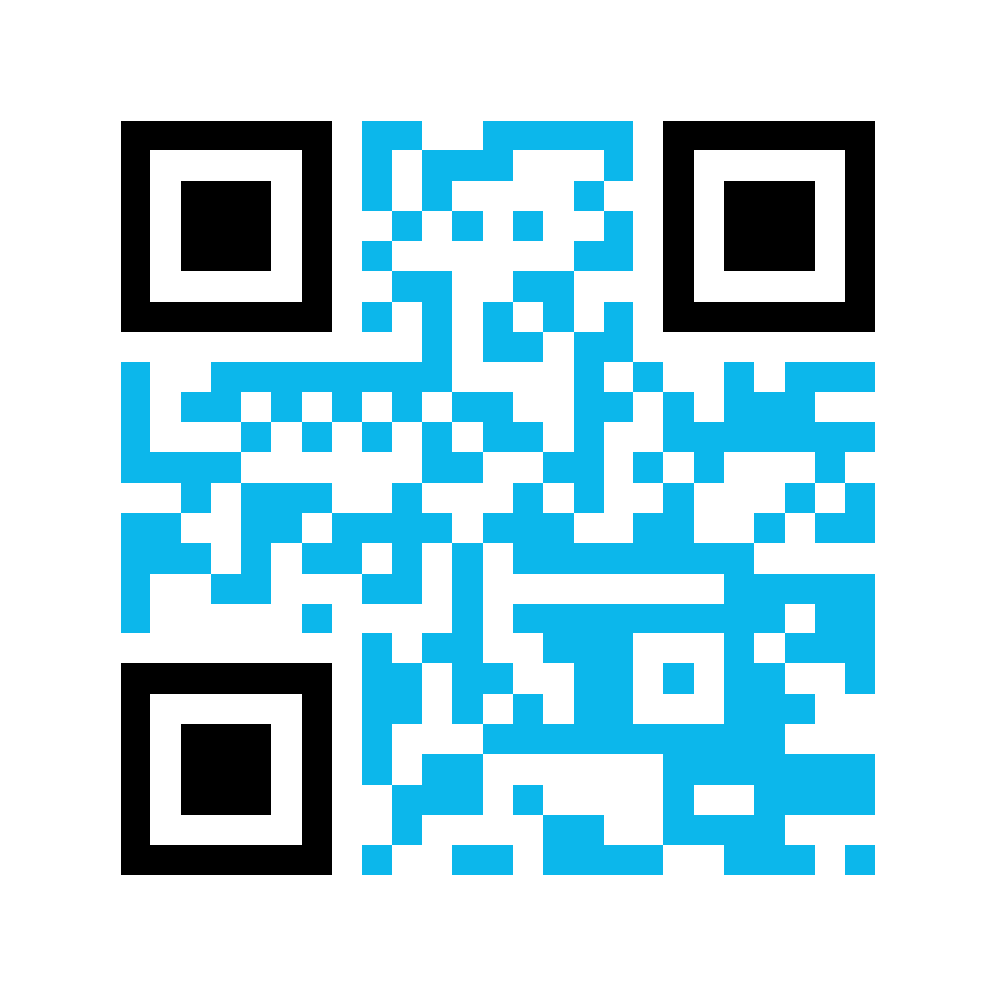
Complete
Tell us what you learned from this session. Please complete this short survey.
bit.ly/PeaceActPostSurvey
© YYYY Peace Through Action ® USA
19
Notes:
Distribute session summary sheets to participants.
Peace Through Action has prepared information for you to take with you. It has QR codes and weblinks to actions to continue what we started today.
Peace Through Action asks you to complete a brief survey about what you learned from this session. It helps them figure out if this session is doing what it’s supposed to. It also helps them report to donors and supporters.
If you are passing out print post session surveys…
I’m passing around the survey now.
If you are also directing/only directing participants to an online post-session survey…
You can complete the survey online by scanning the QR code on the session summary sheet and complete the survey online.
If using the PowerPoint presentation
You can scan the QR code on this slide and complete the survey online.
I’m going to give us time to complete the survey before we go.
Pause 3 minutes while participants complete post-session survey.
Next Slide

Slide 20
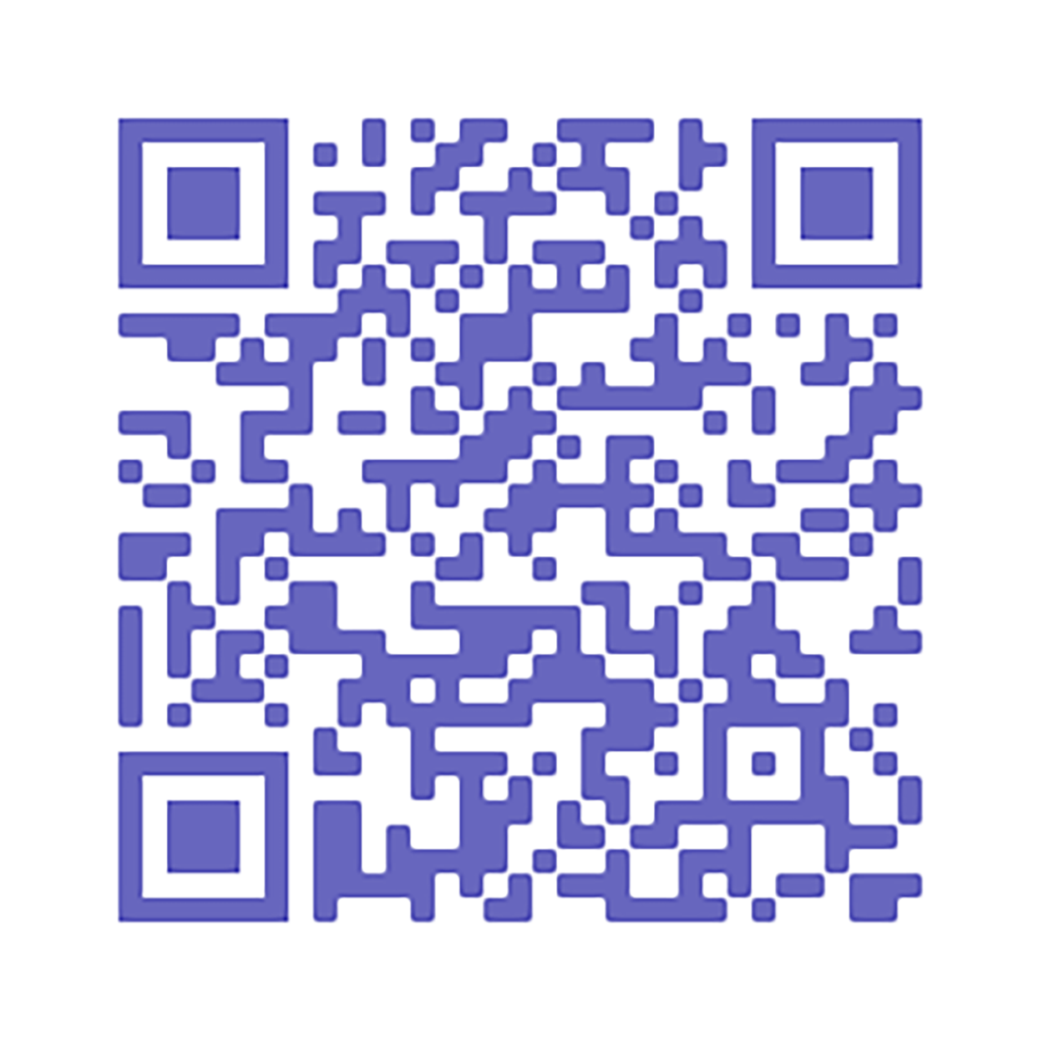
Sign Up
Keep up with us by email.
peacethroughaction.org/email
© YYYY Peace Through Action ® USA
20
Notes:
Also, Peace Through Action requests your email addresses so that they can follow up with you after this session and explore how they can help you continue your interest. Providing contact information is voluntary, of course, but I hope you will consider it. You can unsubscribe from their email any time.
If you are passing out a print sign-up sheet…
I’m passing around a sign-up sheet.
Pass around the sign-up sheet.
If you are also directing/only directing participants to an online sign-up sheet…
You can scan the QR code on the session summary and sign up online.
If you are using the PowerPoint presentation…
You can scan the QR code on this slide and sign up online.
Next Slide

Slide 21
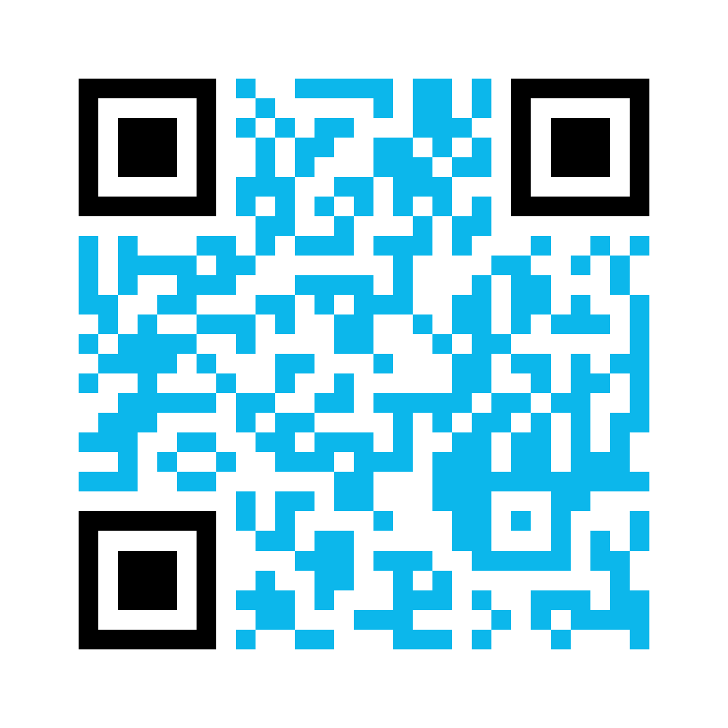
Consent
Complete our media release to give us permission to use your name, voice, and/or image.
bit.ly/PeaceActMediaRelease
© YYYY Peace Through Action ® USA
21
Notes:
If a group or individual picture will be taken at the conclusion of the session…
Before we go, I’d like to take a picture of our group. The picture will be a resource for Peace Through Action to show off our action and for us to share with our friends and colleagues. Would that be okay?
If all or most participants consent…
Peace Through Action does request each of us to complete a media release so that they know your intentions with any pictures or videos taken today.
If you are passing out print media release forms…
Take a moment now to read and complete the media release form.
If you are also directing/only directing participants to an online media release form.
You can scan the QR code on the session summary and complete the media release form online.
If you are using the PowerPoint presentation
You can scan the QR code on the slide and complete the media release form online.
Pause while participants complete media release forms.
Next Slide

Slide 22








Connect
@peaceactusa
linkedin.com/company/peace-through-action-usa
@peacethroughaction.org
© YYYY Peace Through Action ® USA
22
Notes:
Some other things you can do with Peace Through Action, all of which are covered in the session summary, include connecting with them on social media…
Next Slide

Slide 23
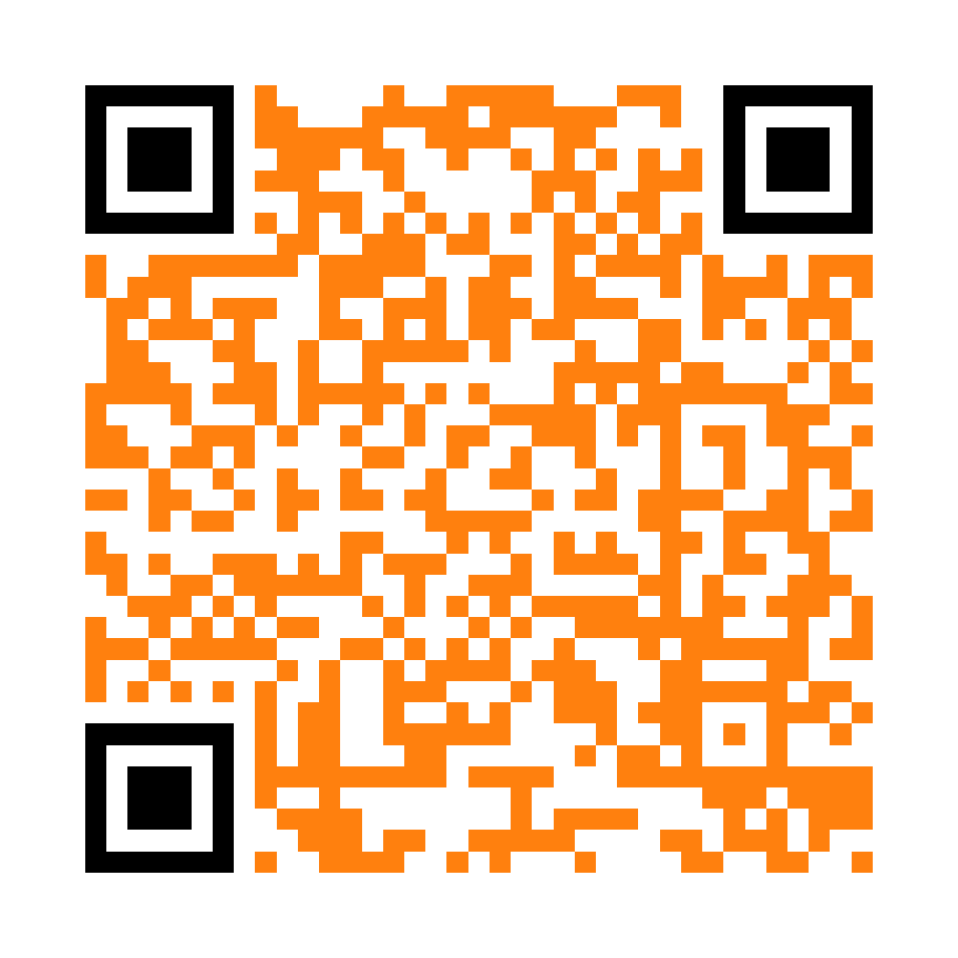
Volunteer
  Boost our social posts.
  Teach a peace skill.
  Host an action meet-up.
  Write issue briefs.
  Join our board of directors.
  Propose your own activity!
peacethroughaction.org/volunteer
© YYYY Peace Through Action ® USA
23
Notes:
…volunteering as an activity leader like I’m doing today…
Next Slide

Slide 24
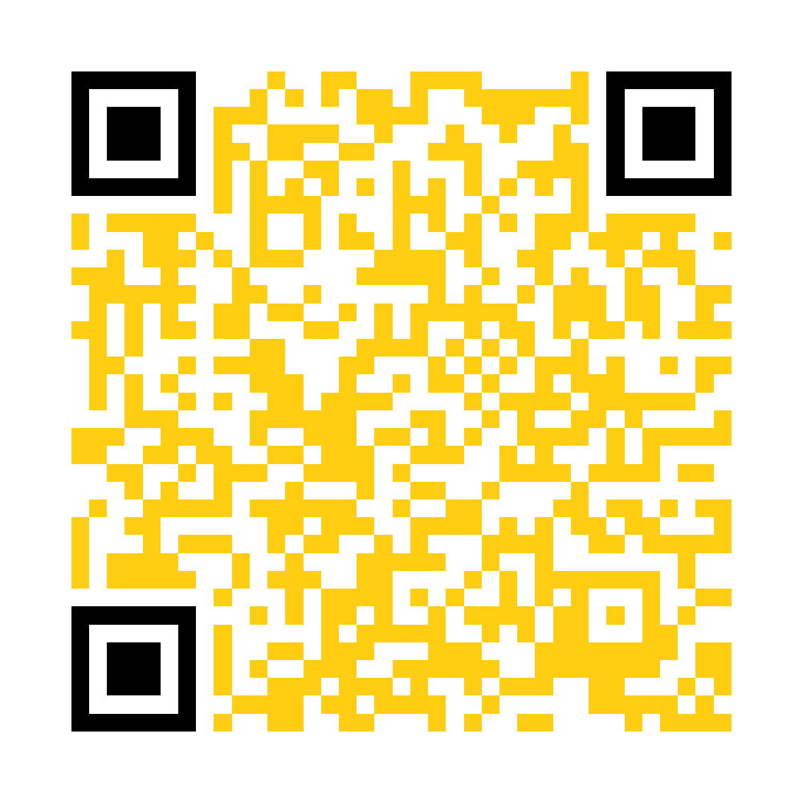
Give
Support our mission activities with a gift of money for peace.
peacethroughaction.org/give
© YYYY Peace Through Action ® USA
24
Notes:
… or giving a gift of money to support their mission work.
Next Slide

Slide 25
Peace Through Action USA
P.O. Box 73466
Washington DC 20056-3466
202-827-5967
peacethroughaction.org
inbox@peacethroughaction.org
Contact
© YYYY Peace Through Action ® USA
25
Notes:
I hope you have found this time together pleasant, useful, and meaningful. I can’t thank you enough for making time to learn about what you can do, and that we can do together, to increase peace in our relationships and communities. Thank you!

